Slide 1


HTU/ Pearson
CENTRE guidelines
TO QUALITY ASSURANCE
CENTER # 91929

Slide 2


So, What’s Are we Looking at
Illustration by Ben Wiseman
General Introduction
Programme/s Delivery
Key Templates for students
Assessment Process – Assignments – Grading
System
Annual Student Survey
HNGlobal Account ( Student Portal)
Centre Support – documents, resources,
specification features and changes, training

Slide 3
WHAT DOES BTEC STAND FOR ?
Business and Technology Education Council
BTEC Programmes are VOCATIONAL
BTEC Higher Nationals are
taught to over 100,000
students in 58 countries
worldwide?

Slide 4




Slide 5
HOW MANY CERTIFICATES CAN I GET FROM HTU?
HOW MANY TIMES CAN I BE ABSENT FROM CLASSES ?
WHAT HAPPENS IF I SUBMIT MY ASSIGNMENT LATE?
WHO CAN I TALK TO IF I HAVE A PROBLEM ?
WHY ARE FOUNDATION COURSES IMPORTANT ?
ARE THERE OPPORTUNITIES FOR TRAVEL ?
WHAT IS HNGLOBAL ?

Slide 6
WHY CHOOSE BTEC HN
BECAUSE
It provides LEARNING OUTCOMES (LO) based curriculum
It provides HANDS-ON Experience for future careers
It is an opportunity for Learning by Doing
It is to become JOB-READY
It meets the requirements of the Modern World Industries
It is a Kick-Start for young peoples careers
Robust Quality Assurance Measures
APMR + Annual Student Survey
Annual BTEC AWARDS

Slide 7
BTEC HIGHER NATIONALS
https://www.youtube.com/watch?v=uuyynIBDgeU
https://qualifications.pearson.com/en/qualifications/btec-higher-nationals/about.html

Slide 8
Approved Full Awards
BTEC HN (RQF)
Construction And The Built Environment
Engineering
Computing
HNC
8 UNITS L4
Progression GPA 2.3
Progression GPA 2.6
HND
8 UNITS L5
HTU BSc

Slide 9
Roles and Responsibilities
In the IV Process
Senior Manager
Head of Center
HTU President
Dean’s Council
ISV (EE)
International Standard Verifier
Quality Assurance Nominee
PQO’s
(Pearson Qualification Officers)
Assigned for each School
Examination Officer
(Registrar or Admin)
Programme Leader (LIV)
(Dean)
Assessment Board
Lead Internal verifier (LIV)
(Dept. Chair – Subject Specialist)
Internal verifier
(Instructors and Faculty)
Assessors
(Instructors and Faculty)
Students

Slide 10
WHAT IS Internal QUALITY ASSURANCE
Pearson uses quality assurance to ensure that Centres are working to set quality standards and Best Practices to deliver and safeguard BTEC qualifications.

Slide 11
Role of the External Examiner
(EE)
Pearson employs experts (External
Examiners (EEs) to work with you to
ensure standards are met.
• Your contracted EE will visit you twice per
Year
• A report will be produced after each visit
• Until one cohort of students has completed the programme the decision of the EE will be ‘Not Yet Fully Sampled’

Slide 12
( Key IV Templates) – For students
Assignment Brief
Scheme of Work (SOW)
Assignment Feedback
Student Declaration
Student Resubmission
Discontinue Unit form
Authorized Extension(for late work)
Grade Appeal
FOLLOW
THE ACADEMIC CALENDAR

Slide 13
Units, Credits and
Total Qualification Time (TQT)
1 BTEC UNIT = 15 credits in value
(TQT)
150 hours
Guided Learning hours (GLH)
60
Independent learning 90 hours
Examples of activities that contribute to (TQT)
Guided Learning
Independent unsupervised research learning
Unsupervised compilation of a portfolio of work experience
Unsupervised e-learning
Unsupervised e-assessment
Unsupervised coursework
Watching a pre-recorded podcast or webinar
Unsupervised work-based learning

Slide 14
BTEC RULES OF UNIT COMBINATION
(example )
HND L5
( Mechanical Engineering)
It is expected that an HND student has achieved at least 90 credits at HNC (L4) before progressing to HND (L5)
Total required credits
240
Mandatory Units
180
Optional Units
30
Specialist Units
30

Slide 15

Learning Outcomes & Assessment Criteria
Illustration by Lucy Vigrass
RQF Assessment is at Learning Outcome level
Learning Outcomes describe exactly what students must be able to do when they are assessed
Learning Outcomes have Assessment Criteria
Assessment Criteria provide the standard of expected performance that a student is required to evidence in order to meet the learning outcome, AND;
The depth or detail they need to evidence in their understanding or skill to achieve the higher grades.
Notes:
The pass assessment criteria are to be evidenced in the student work in order for the student to meet the pass. The depth of knowledge and understanding is measured by the merit and distinction criteria that are now given . A student cannot achieve the distinction without fulfilling the rest of the criteria for pass/merit.
When writing the assessment brief guidance the need to maintain the integrity of the operative/command verbs should be
explained with examples such as ‘if we ask students to ‘explain’ and the verb is ‘evaluate’, we are under-assessing. However, if we ask
students to ‘explain’ and the LO/AC requires an ‘outline’, we are over assessing.
Higher assessment criteria will require higher level operative verbs e.g. ‘critical evaluation’ and so when assignment briefs are written that should also be taken into account to enable students to achieve them.
The assessment is now holistic so assignment briefs should not be broken down in to tasks but one overall form of assessment with guidance on the evidence that is required is to be produced.

Slide 16

An Assignment is:
Illustration by Ben Wiseman
An assessment tool
Designed to allow students to demonstrate knowledge, skills and understanding.
Based on an appropriate assessment activity (e.g. report, essay, presentation, project, exam, etc.)
Based on a vocational scenario or context
Notes:
The assignment brief is a written document given to students at the start of the assessment process for a unit
It can be issued as hard copy and/or online but must be kept as a record of the assessment process
The assignment is a written instruction for students to carry out a series of tasks/activities, through which they will produce evidence that will be assessed against the targeted assessment and grading criteria for a unit
As BTECs are vocational qualifications, assessment should take place within a vocational scenario or context
The design of the assignment tasks will enable students to produce works that is relevant, current, authentic, etc.

Slide 17

Unit Grading
The Mastery Model is on the principle to that a student muct achieve ‘mastery’ of prerequisite knowledge or skill
 |  | Assessment Criteria
 |  | Pass | Merit | Distinction
Grade | Pass | X
 | Merit | X | X
 | Distinction | X | X | X
Illustration by Tang Yau Hoong
Notes:
Review of mastery model of assessment. Use quiz on next slide to discuss the achievement of unit grades. Stress the fact that the lowest achievement in a single learning outcome will set the overall unit achievement. This is not new. This has been the assessment model for HNs for some time.

Slide 18
ASSESSMENT CRITERIA AND GRADING with btec hn’s (rqf)
Assessments are graded Pass, Merit and Distinction.
Pass criteria are set as the threshold of meeting the Learning Outcome for each unit.
Merit and Distinction criteria define the depth and breadth of knowledge and understanding the student has evidenced in meeting Pass criteria

Slide 19
To achieve a PASS a Student
must have satisfied all PASS criteria for the LO’s, showing coverage of the UNIT content
To achieve MERIT a Student
must have satisfied all the MERIT criteria ( and the Pass criteria) through high performance in each Learning Outcome
To achieve a DISTINCTION a Student
Must have satisfied all the DISTINCTION criteria ( and the Pass and Merit criteria),and these define outstanding performance across the unit as a whole.

Slide 20
What is a grade?
What is a grade?
It is a reflection of a student’s accumulative performance holistically
It is hierarchal: students have to achieve all pass, merit and distinction criteria across the UNIT as a whole to earn a distinction.
Pass
(ILO example- Explain)
Merit
(ILO example- Analyze)
Distinction
(ILO example create/construct)

Slide 21
U n c l a s s I f I e d
. Students who do not satisfy the Pass criteria should be reported as Unclassified = ( U )

Slide 22
Quiz
For a UNIT with four learning outcomes, a student is awarded P, M, D, D. What is their overall unit grade?
Notes:
The answer is Pass – because the student has not achieved ALL MERIT and ALL DISTINCTION. Effectively, the lowest achievement of a learning outcome will set the achievement of the overall unit.
This is NOT new. This is how HN’s have been assessed for a very long time. Variations in practice are not accepted.

Slide 23





Assessment Process
Assessment
Decisions
Grade
(P/M/D)
Assignment
Submission
Feedback
=

Slide 24

Assessment Process
Assignment
Submission
Assessment
Decisions
Grade
(P/M/D)
Feedback
=
=
Assignment
Resubmission
Capped
at
Pass

Slide 25

Assessment Process
Assignment
Submission
Assessment
Decisions
Grade
(P/M/D)
Feedback
=
=
Assignment
Resubmission
Capped
at
Pass
Capped
at
Pass
=
RETAKE

Slide 26

The Holistic Assessment Approach
Holistic assessment is when the assessor makes academic judgements on grading based on the assignment as a WHOLE, rather than as a separate breakdown of tasks.
Each part of the ‘MEAL’ will reflect aspects of the criteria
( selection of ingredients, skill in preparation, etc.) where one part may be seen to be lacking (or missing?) evidence may be found elsewhere in the work.
The student may me awarded for the inclusion.
Selection of ingredients
Skill preparation
Taste
Presentation

Slide 27
Forms of Evidence for Assessment
Planning Documents
Case Studies
Project
Oral/Viva
Recorded Discussion
Reports
Performance
Peer Review
Log Books, Diaries, etc.
Written Investigation
Essay/Dissertation
Discussion Forum
Artefacts
Blog/e-Journal
Independent Research
Examination
Presentation Handouts, etc.
Role-play
Time-constrained Assessment
Work-based Learning
Witness Statements
Annotated Photographs
Self-reflection
Multiple Choice
Fill in the Blanks

Slide 28
Formative assessment
Why is it important?
Formative assessment is an integral part of the BTEC assessment process, involving both the Assessor and the Student in a two-way conversation about their Progress.
It takes place prior to summative assessment and does not confirm achievement of grades, but focuses on helping the student to reflect on their learning and improve their performance.
The main function of formative assessment is to provide feedback to enable the student to make improvements to consolidate a Pass, or attain a higher grade.
Must not coach students with specific advice on what to do for summative assessment
Formative assessment should use the language/verbs from assessment criteria to help students understand achievement/progress and how to move forward.
The informal verbal feedback process is an ongoing process, however, it is good practice to have at least one formal written formative assessment feedback..
This feedback should be prompt and meaningful allowing sufficient time following the feedback for ACTION to improve the learner’s performance.

Slide 29
Summative assessment
Summative assessment is the Final Consideration by an Assessor of a student's assignment, agreeing which assessment criteria the student has met in the assignment and recording those decisions.
It is not expected that students are offered opportunities to revisit assignments at this stage of the assessment process unless approved by the Programme Leader.
Students will need to be familiar with the assessment criteria so that they can understand the quality of what is required. They should be informed of the differences between grading criteria so that higher skills can be achieved.

Slide 30
P l a g I a r I s m
The authentication of student evidence is the responsibility of the Centre.
If during external examination, the International Standard Verifier (ISV) raises concerns about the authenticity of evidence
The Centre will be required to investigate further. Depending on the outcomes, penalties may be applied.

Slide 31
Honor System and Plagiarism Policy at HTU
( HTU Online Portal)
What counts as Plagiarism?
Plagiarism is the use of another’s work words, or ideas without attribution, deliberately or recklessly
The Dean reviews evidence Description by provided by Instructor
Plagiarism report filed with the Quality Nominee and the Dean of School via a notification report system online (portal)
Dean takes action depending on the individual case. If needed forms a committee to choose an appropriate action
Deans Council reviews recommendation only for suspension snd expulsion
If the case is severe , a Committee reviews the evidence and interviews faculty and student
Committee issues recommendation for the Deans’s Council
Plagiarizers suffer serious consequences including suspension or expulsion from HTU.

Slide 32
Can a student re-submit an assignment?
A student who, for the first assessment opportunity, has Failed to achieve a Pass for that unit specification shall be expected to undertake a reassessment (resubmission)
Only ONE opportunity for reassessment of the unit will be permitted
Reassessment for coursework, project or portfolio-based assessments shall normally involve the reworking of the original task
For examinations, reassessment shall involve completion of a new task.
A student who undertakes a reassessment will have their grade for that unit
Capped at a Pass

Slide 33
R e s u b m I s s I o n
Resubmissions can be authorised by the Programme Leader or the Assessment Board (Department Board) and should only be authorised if all of the following submission conditions are met:
The student has met the initial deadlines set in the assignment, has met an agreed deadline extension, or has submitted work late that has been accepted
The assessor judges that the student has fully attempted to achieve all targeted learning outcomes in their original submission
The assessor judges that the student will be able to provide improved evidence without further guidance
The assessor has authenticated the evidence submitted for assessment.

Slide 34
Resubmissions
The Lead Internal Verifier can authorize resubmission if the following conditions are met
What If a learner does not meet all these conditions?
If a learner has not met these conditions, re-submission will not be authorized.
The learner has met initial deadlines
The Assessor judges that the learner will provide improved evidence without further guidance.
The Assessor has authenticated the evidence, and the evidence is accompanied by a signed-and-dated declaration of authenticity by the learner
Specification Requirements for Resubmissions
A student who, for the first assessment opportunity, has failed to achieve a Pass for that unit specification shall be expected to undertake a reassessment.
● Only one opportunity for reassessment of the unit will be permitted.
● Reassessment for course work, project or portfolio-based assessments shall normally involve the reworking of the original task.
● For examinations, reassessment shall involve completion of a new task.
● A student who undertakes a reassessment will have their grade capped at a P for that unit.
● A student will not be entitled to be reassessed in any component of assessment for which a Pass grade or higher has already been awarded.
Procedures for resubmission
Forms and deadlines
If the LIV does authorize resubmission, it must be:
Recorded on the assessment record
Given a deadline for re - submission within 15 working days* of the learner receiving the result of the assessment.
Undertaken by the learner with no further guidance
*15 working days must be within term time, in the same academic year as the original submission
Forms and deadlines
If the LIV does authorize resubmission, it must be:
Recorded on the assessment record
Given a deadline for resubmission within 15 working days* of the learner receiving the result of the assessment.
Undertaken by the learner with no further guidance
*15 working days must be within term time, in the same academic year as the original submission

Slide 35
R e p e a t U n I t S
The following applies to a student who, for the first assessment opportunity and resubmission opportunity, still failed to achieve a Pass for that unit specification:
● At the provider’s discretion and Assessment Board, decisions can be permitted to repeat a unit.
● The student must study the unit again with full attendance and (if required) payment of the unit fee
● The overall unit grade for a successfully completed repeat unit is Capped at a Pass for that unit.
● Units can only be repeated once.
● The External Examiner is likely to want to include assessments that have been resubmitted as part of the sample they will review.

Slide 36
S t u d e n t A p p e a l s
A student appeal is a request to review decisions made by the Centre on their progression, assessment and awards.
The Centre should have in place a means for ensuring all students and staff are aware of:
  what constitutes an academic appeal and what is considered assessment malpractice
  the related processes for instigating an appeal or investigating malpractice the possible outcomes that may be reached
  the consequences of both internal and external outcomes
  the process that exists to enable students to make an appeal with Pearson relating to external or internally awarded assessment outcomes.

Slide 37
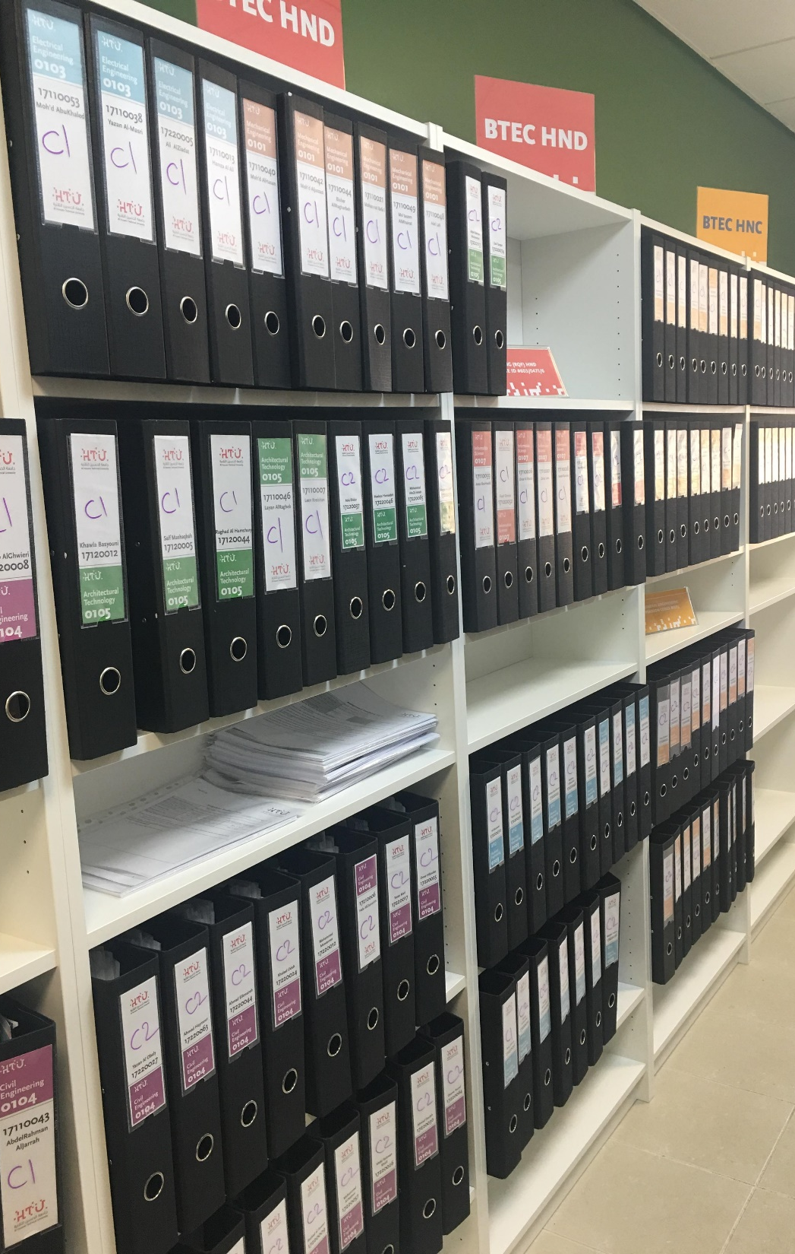
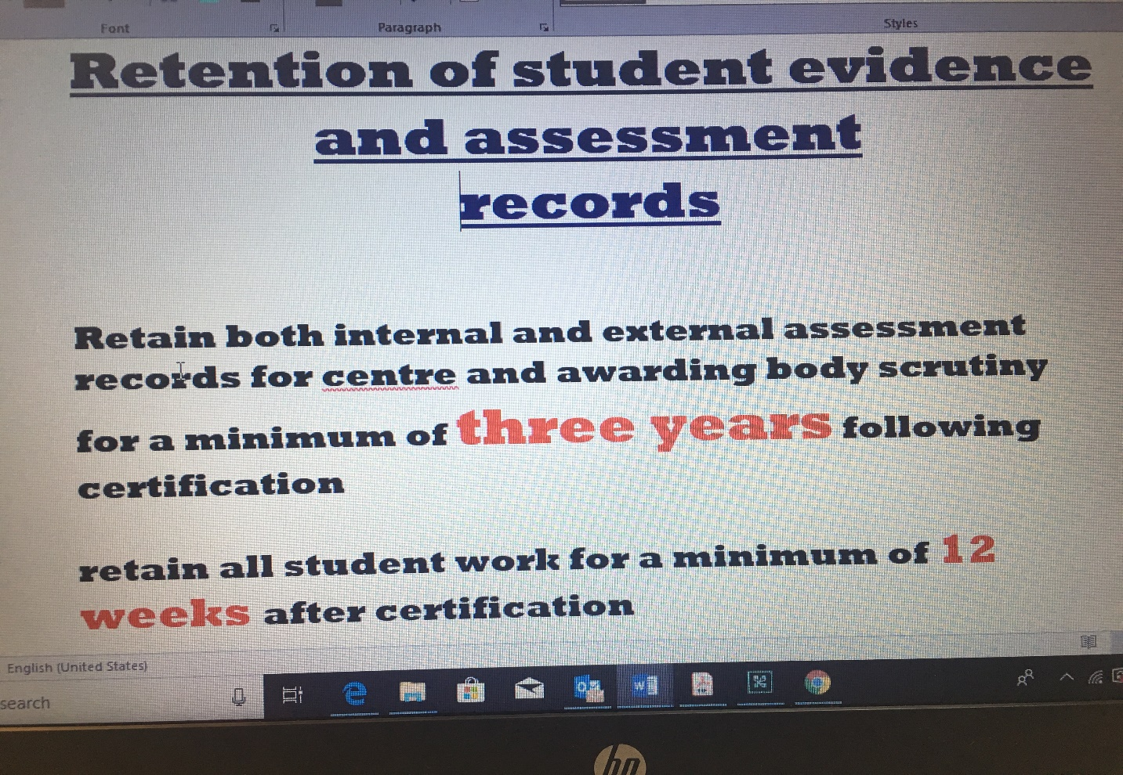
S02 – Quality Assurance Verification Room

Slide 38
GLOSSARY OF BTEC TERMINOLOGY
( useful links)
BTEC | Business and Technology Education Council
APMR | Annual Programme Monitoring Report
ISV | International Standard Verifier
RQF | Regulated Qualification Framework
HN Global | HN Global is an online resource that supports provider planning and delivery of BTEC Higher Nationals https://hnglobal.highernationals.com/ https://qualifications.pearson.com/en/qualifications/btec-higher-nationals.html https://qualifications.pearson.com/en/contact-us/teachers.html support@highernationals.com
IV QA | Internal Verification Quality Assurance
Provider | The Center ( us)
Learner | The student
QN | Quality Nominee
TQT | Total Qualification Time
GLH | Guided Learning Hours
Annual Student Survey | http://bit.ly/2JNVgJT
NOP | Notification of Performance
Key Documents | https://qualifications.pearson.com/en/home.htm
HNC | Higher National Certificate
HND | Higher National Diploma
EOL | Edexcel Online
LIV | Lead Internal verifier

Slide 39
FOR SUPPORT AND GUIDANCE
VISIT THE
QULIATY ASSURANCE
UNIT
AT S11
Notes:
Using the handout, have the delegates work in subject-related groups to develop a vocational scenario for a unit of their choice. Have a couple of groups share their scenario and get the rest of the group to comment on its appropriateness. Does it give the student a clear role, at the appropriate level? Does it give a relevant and up-to-date context? Is the overall presented clearly?

Slide 40

IT TAKES A VILLAGE AND A MIND SHIFT!!
Thank You

