Slide 1

HTU and Pearson: Higher Technical Education – Presentation to the Board of Studies
Frank Edwards & Ian Bani
Image placeholder
Image by Photographer’s Name (Credit in black type) or
Image by Photographer’s Name (Credit in white type)
Image by Davide Bonnazi
Jordan, 29 January 2020
Presentation Title Arial Bold 7 pt
1

Slide 2
HTU Development
Pearson experience in Jordan, regionally and globally.

Slide 3
BTEC was instrumental in bring about that change
Creating the UK Knowledge Based Economy

Slide 4
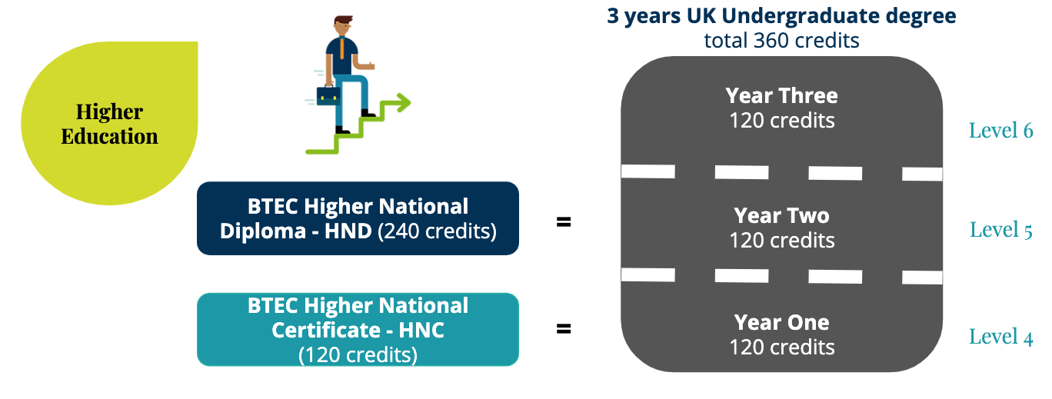
What is a BTEC Higher National Qualification?

Slide 5
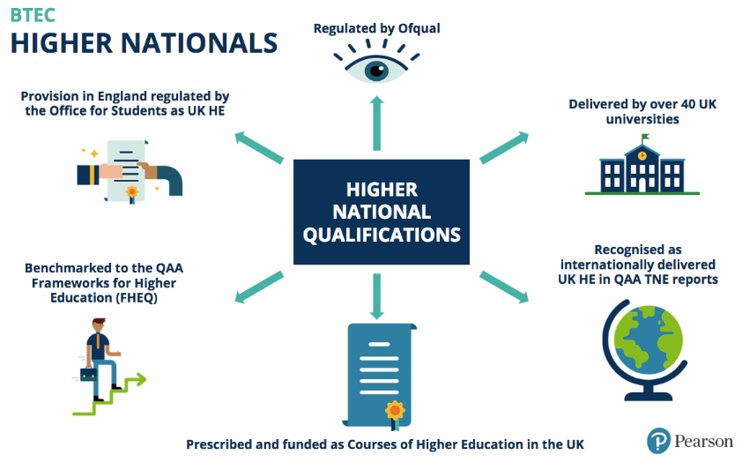
External Recognition and Bodies
Notes:
Pearson has previously been involved in a number of QAA TNE reviews where the QAA has incorporated one or more of our providers (Caribbean, Ireland, Pakistan).

Slide 6


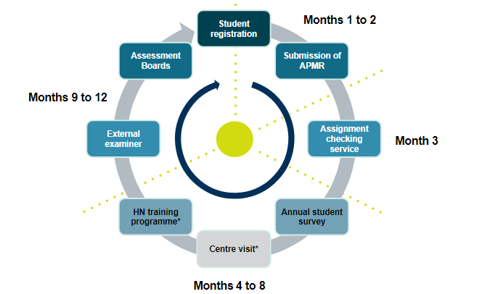


Enhanced Quality Assurance
Annual Student Survey
An annual opportunity for al HN students to survey provide valuable and quantifiable feedback on their Pearson BTEC Higher Nationals experience. Pearson uses responses to develop and improve our HN provision.
Assessment Boards
Each centre is expected by Pearson to hold Assessment Boards for all of its BTEC Higher National programmes.
Annual Confirmation Fee
To assist centres in regularly monitoring their active students, all centres pay an administrative annual student confirmation fee. Applicable only to students in their second or subsequent year of study.
Annual Programme Monitoring Report (APMR)
An annual overview of HN provision reviewing the previous year which providing valuable feedback to Pearson.
Notes:
Standard QA model - (see cycle in box) EE (International Standards Verifier -ISV) visits a centre twice each academic year until the centre has established a good QA profile and then visits go down to once per year. The centre visits and HN training are built into the QA cycle as needed by the centre or required by Pearson due to quality issues.
Assessment Boards - meeting(s) to carry out an internal check on all student awards before certificates are claimed from Pearson. External Examiner can attend these meetings where possible, but must be sent the minutes of each meeting.
Annual Student Survey - provides a voice to all HN students globally and responses go directly to Pearson. Provides invaluable feedback and feeds into our annual quality cycle, continuous improvement and efficacy metrics. If a centre has a sufficient number of responses, Pearson will provide a bespoke report benchmarking the centre’s performance in light of the global average performance.
APMR - standard HE practice and integral to UK HE. Pearson’s APMR focuses on HN provision and provides an opportunity for the centre to reflect on the previous academic year, areas for improvement, areas of good practice, completion or ongoing monitoring of actions, outcomes of EE reports and the feedback provided from the annual student survey.
Annual Confirmation Fee - currently set at £21. Pearson regularly checks its systems to confirm the number of active students who have progressed into their second or subsequent year of study. Centres should register, progress, withdraw, delete or claim certifcation their students in a timely manner and the annual confirmation fee enables Pearson to monitor this activity.

Slide 7
HE curriculum development - working with employers to meet the needs of industry

Slide 8

Developed for student employability
    Clear purpose linked to progression
    Content and purpose defined via stakeholder engagement
    Embedded professional body standards
    Design features increasing work-relatedness of new HNs (flexible design for localisation, use of projects, mapping 21st century skills)
    Content reflecting global student population and global progression
    Attention to total skills domain (including behaviours)
    Mapping to higher education qualification descriptors and subject benchmark statements to ensure correct level of demand
Pearson BTEC Higher Nationals

Slide 9
Employer Engagement
Computing:
CompTIA
British Computing Society
CISCO
Rakuten
Fujitsu
IBM
Deloitte
Oracle
Hewlett Packard
Sport:
Preston North End Football Club
CIMPSA
Life Labs
The RFU
Sports Coach UK
Engineering:
Alstom
BMW
Jaguar Land Rover
Railtrack
Sellafield Sites
Siemens
GEN2
Healthcare
Royal College of Nursing
Health Education England
Central and North West London NHS Foundation Trust
Hillingdon Hospital NHS Trust
Nuffield Health
Construction:
Cundall
Vinci Construction
Balfour Beatty
Laing O’Rourke BRE
Bentley
Art & Design:
Together Design
The Partners
Autodesk
BWA Design
Creative Media:
The Mill
LionTV
BBC
422.tv
Relay.fm
Playground Squad
Music:
Kobalt
Rocket Music
BBC
PRS
Ministry of Sound
Planet Earth Publicity
Fluid Mastering
Karrie Keyes
Performing Arts:
Royal Shakespeare Company
New Adventures
Really Useful Group
Belfield and Ward
Matthew Bourne
LAMDA
BBC
Hospitality:
Marriott Hotels
Baglioni Hotels
Liquid Chefs
Edge Hotel School (University of Essex)
Hosco
Institute of Hospitality
Travel and Tourism:
Different Snow
Discover the World
Smart Aviation

Slide 10














Professional Recognition
BTEC (RQF) HNs
HNs in Business
HNs in Computing
(mostly vendor quals)
HNs in Engineering
HNs in Construction
Find all Professional Body recognition on our website
Pearson BTEC Higher Nationals
Notes:
Qualifications developed in conjunction with professional bodies/vendor qualifications.
Units and selected specialist pathways are mapped against Professional Bodies’ requirements; some have obtained exemptions to facilitate routes to professional certification.
Units and specialist pathways selected are mapped against Professional Bodies’ requirements
Example: HN in Business
The Level 5 Accounting and Finance pathway includes units that are recognised and accredited by
ACCA (The Association of Chartered Certified Accountants):
Exemption from 4 of a potential 9 papers which are part of the ACA qualification (Leads to Chartered Accountant status.
CIMA (The Chartered Institute of Management Accountants):
Exemption from 3 of the 4 papers that make up the Certificate in Business Accounting, needed for entry onto CIMA’s Professional qualification
CIPD (Chartered Institute of Personnel and Development ):
Exemption from 3 of a possible 11 units in the CIPD Level 5 Certificate in Human Resources Management
Exemption from 3 of a possible 13 units in the CIPD Level 5 Diploma in Human Resources Management
CIPS (Chartered Institute of Procurement and Supply)
Exemption from 2 of the core units (total 5) to achieve CIPS Level 5 Advanced Diploma in Procurement and Supply
Letters of professional body recognition
China
Malaysia
Singapore
Global

Slide 11

Employment Routes in which Pearson provides qualifications that are mapped to Employer’s Requirements
Engineering and Manufacturing
Construction
Business and Administration
Health and Science
Catering and Hospitality
Digital
Education and Childcare
Transport and Logistics
Illustration by Lucy Vigrass
Notes:
Beyond our Accredited (regulated) qualifications, we will work with employers to co-design qualifications to meet their specific training need, our expertise in vocational learning and development and capacity to turnaround high quality qualifications often to tight timescales means that we work efficiently to maximise value of the qualifications to employers.

Slide 12
Recent changes to the UK education landscape including Institutes of Technology Model

Slide 13

High potential landscapes
Level 4 and 5 being recognised as an educational landscape with huge productivity potential in the UK
In 2017 the Department for Education began a wholescale review of Level 4-5 education in England - a market review investigating supply (providers e.g. AOs) and demand (students)
Aim is to strengthen further the reputation and uptake of level 4 and 5 qualifications like the Higher Nationals, which can significantly impact on an individuals’ life chances and employment prospects.
Students who complete level 4-5 qualifications can benefit from higher wages.
Putting employers front and centre in the design and recognition process.
Ensuring quality of provision is high and consistently so across the nation.

Slide 14
The ‘Institute of Technology’ model
- The UK government has allocated £170m to establish new Institutes of Technology (IoTs), which will specialise in delivering the higher level technical skills that employers need.
- IoTs deliver provision to students that is highly sought after by employers, in technical disciplines, particularly STEM (science, technology, engineering and maths).
- Focusing on levels 4 and 5 to develop higher technical skills (80% of provision).
- Created through innovative collaborations between employers and FE and HE providers; harnessing the teaching expertise of HE and FE, research expertise of HE, and industry knowledge and expertise from employers.
Case study: West London IOT - HCUC - Pearson involvement, Brunel (university partner), Heathrow, Fujitsu, range of other employers
Benefits for employer: solve real world problems for employers …to improve productivity and add economic value in west London
Benefits for students: line of sight to employers & employment and higher education; excellent career prospects and earning potential; project briefs designed by employers; highly qualified staff with industry expertise; high quality specialist facilities
Employer led approach:
        Employer Advisory Group
        Co-write curriculum - responsive to employer needs locally and beyond
        Shape student experience (e.g. as visiting technical fellows)
        Labour market insight

Slide 15
The HTU is ahead of the curve and is an outstanding development by any measure

Slide 16
Pearson is committed to working in Partnership and to supporting the HTU to be a regional Centre of Excellence for Higher Technical Education
Find out more about us at
  qualifications.pearson.com/higher-nationals

